Slide 1
Sexually transmitted infections and HIV
SHARE Lesson 5

Slide 2
WCSD Abstinence Definition
  Sexual Abstinence is defined as refraining from all forms of sex and genital contact such as vaginal, oral and anal sex.
  An abstinent person is someone who has either never had sex or someone who’s had sex but who has decided not to continue having sex for a period of time.
  Abstinence is the only 100% effective way to prevent HIV, other sexually transmitted diseases or infections and pregnancy.
    SEX-when a person’s genitals touch another person’s genitals, mouth or anus.

Slide 3

Communication

Slide 4

BEFORE you have sex…TALK!
  Abstinence- clearly communicate personal definitions of abstinence with your partner.
  “Let’s get tested before we have sex. That way we can protect each other."
  “Many people who have an STD don't know it. Why take a chance when we can know for sure?”
  There are other things you may want to talk to your partner about, such as:
    Sexual history – the number of partners you’ve had and what kind of protection you used (for example, condoms or dental dams)
    Risk factors – like whether you’ve had sex without a condom or used drugs with needles

Slide 5
Sexually Transmitted Infection (STI)
Sexually transmitted disease (STD)
STI and STD are often used interchangeably
Notes:
STI is the more accepted term now because it is more inclusive. “Infection, meaning don’t have to have signs/symptoms.
STD means the disease state usually referring to the entire sequelae (a condition which is the consequence of a previous disease or injury.) of issues that go along with the disease as a whole.

Slide 6

Amaze.org
What are STDs? #FactCheck

Slide 7
What are sexually transmitted diseases (STDs)?
STDs are diseases that are passed from one person to another through sexual contact. These include chlamydia, gonorrhea, genital herpes, human papillomavirus (HPV), syphilis, and HIV. Many of these STDs do not show symptoms for a long time. Even without symptoms, they can still be harmful and passed on during sex.
https://www.cdc.gov/std/general/default.htm

Slide 8
How are STDs spread?
You can get an STD by having vaginal, anal or oral sex with someone who has an STD.
Anyone who is sexually active can get an STD.
You don’t even have to have anal or vaginal sex to get an STD.
  This is because some STDs, like herpes and HPV, are spread by skin-to-skin contact.

Slide 9
Stis
Bacterial (curable)
Viral (treatable)
Chlamydia
Gonorrhea
Syphilis
Genital Herpes (HSV)
Genital Warts (HPV)
Hepatitis B ( HBV)
HIV
Hepatitis C (HCV)
Reportable to the Health Department
https://www.washoecounty.us/health/faq/cchs/teen-health-mall/index.php

Slide 10
“The Others”
Trichomoniasis “Trich”
Pelvic Inflammatory Disease
Vaginitis
Crabs (Pubic Lice)
Scabies
https://www.cdc.gov/std/

Slide 11
Bacterial STIs
https://www.cdc.gov/std/default.htm

Slide 12
Chlamydia
Most common reportable STD in the United States
Estimated 2-3 million new cases/year in the US
Almost two-thirds of new chlamydia infections occur among 15-24 y.o.
Most people with Chlamydia are asymptomatic
Untreated disease in females can result in PID
  Which can lead to infertility, ectopic pregnancy and chronic pelvic pain
Untreated disease in males can cause swelling, pain, and infertility
Easily treated and cured
https://www.cdc.gov/std/chlamydia/stdfact-chlamydia-detailed.htm

Slide 13
Symptoms of Chlamydia
Men: 40-50% asymptomatic
7-21 day incubation period
Thin clear to milky discharge from urethra
Burning with urination
Pain or swelling of the testicles
Swollen lymph nodes in the groin area
Women: 70-90 % asymptomatic
Abnormal vaginal discharge
Burning with urination
Pain with intercourse
Lower abdominal pain
Asymptomatic: showing no symptoms of disease

Slide 14
Gonorrhea
Is a very common infectious disease
Often referred to as the “clap”
Over 800,000 new infections in the US/year
Three-fourths are young people 15-24 y.o.
Most people with Gonorrhea are asymptomatic
Untreated disease in females can result in PID
  Which can lead to infertility, ectopic pregnancy and chronic pelvic pain
Untreated disease in males can cause swelling, pain, and infertility
https://www.cdc.gov/std/gonorrhea/stdfact-gonorrhea-detailed.htm

Slide 15
Symptoms of gonorrhea
Most men are symptomatic
Incubation: usually 3-5 days after exposure
Yellow or green pus from penis
Burning with urination
Pain or swelling of the testicles
80% of women are asymptomatic
Abnormal vaginal discharge
Burning with urination
Pain with intercourse
Lower abdominal pain
Nausea and fever
Symptomatic: showing symptoms of disease/infection

Slide 16
Both men and women can get chlamydia and gonorrhea in their throats, rectums and eyes
Rectal infections:
Discharge
Anal itching
Soreness
Bleeding
Painful bowel movements
No symptoms
Throat infections:
Sore throat
No symptoms
Eye infections:
Redness, itching and discharge from the eye
(conjunctivitis)

Slide 17
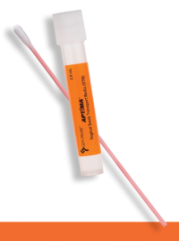
Testing for chlamydia and gonorrhea
Swab sample from:
  the cervix or vagina
  urethra-opening of the penis
  throat
  rectum
Urine sample

Slide 18


Treatment for chlamydia and gonorrhea
Antibiotic
No sex for 7 days after treatment
Sexual partners need to be treated
No sex with untreated partner

Slide 19
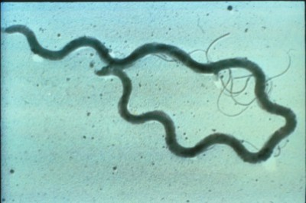
syphilis
CAUSE: Treponema pallidum, a spirochete bacterium that penetrates skin
Known as Syph, Bad Blood, The Great Imitator
100,000+ infections/year in the US
Outbreaks among MSM
Can cause lifelong health issues if not treated
Curable but any damage that has been done may not be reversed
MSM: men who have sex with men
https://www.cdc.gov/std/syphilis/stdfact-syphilis-detailed.htm
Notes:
The Great Imitator – Syphilis gained this nickname because it can mimic the symptoms of other infections. This trait allowed for many patients to be misdiagnosed in the early days of studying this disease.
Bad Blood – This nickname for syphilis dates back to before medical treatment. The Tuskegee Syphilis experiment even used this term to attract patients. This experiment told male patients that they were being treated for “bad blood” when in reality, the U.S. government was studying the long-term effects of untreated syphilis on the human body.

Slide 20
Transmission
Direct contact with syphilis sore/chancre
Spread during vaginal, anal, and oral sex
Infected mother to child during pregnancy

Slide 21
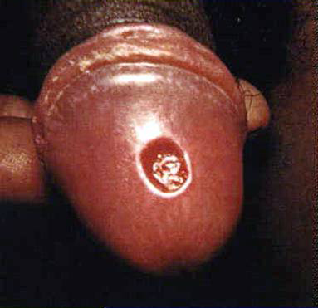
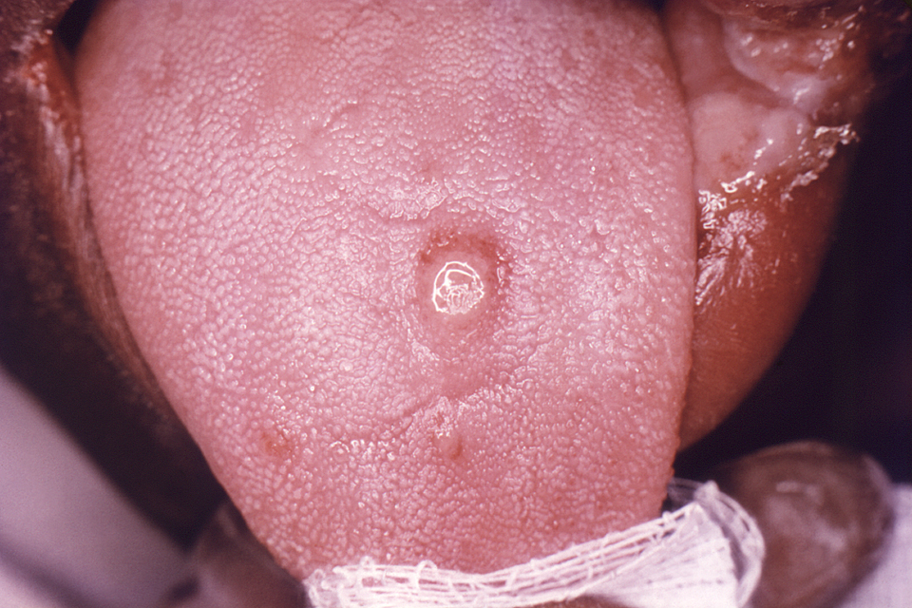
Primary Syphilis:
Ulcer called chancre ("shan-ker")
Typically painless, but may have discomfort due to location, environment
Single sore or kissing sores
Appears 10-90 days after infection (average 2-6 wks)
Disappears within a few weeks even without treatment
May go unnoticed
Sites
Women: Vulva, labia, vagina, cervix, rectum
Men: Penis, scrotum, groin, rectum, under foreskin of uncircumcised penis
Other: tongue, lips, fingers

Slide 22
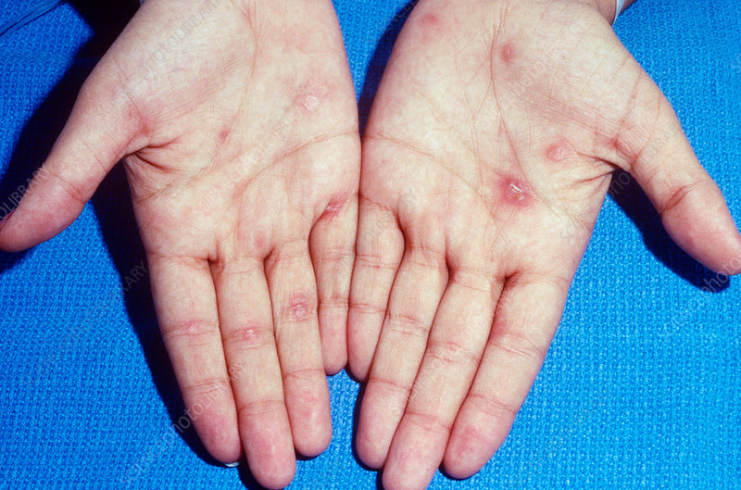
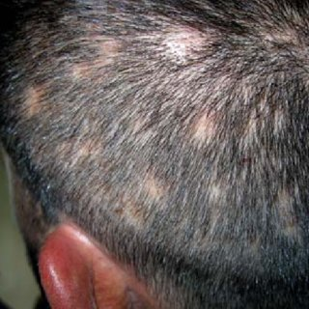
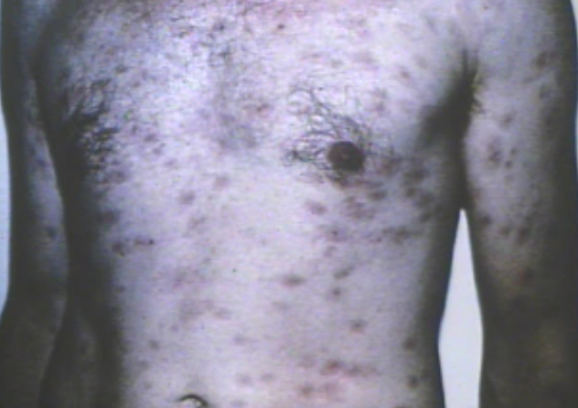
Secondary Syphilis:
Rash:
Usually appears 3-6 weeks after the chancre appears
Characterized by brown sores about the size of a penny, does not itch
Typically on the palms of the hands and soles of the feet, can be on other parts of the body
Flu-like symptoms, patchy hair loss, swollen lymph glands

Slide 23
Tertiary (latent) Syphilis:
No signs and symptoms
Disease no longer contagious
Infection detected only by a blood test
Disease progresses to final stage
Bacterial damage to the heart, eyes, brain, nervous system, bones, joints, or almost any other part of the body
This stage can last for years, or even decades
The final stage can result in mental illness, blindness, other neurological problems, heart disease and death

Slide 24
Congenital Syphilis
A woman passes the infection to her baby during pregnancy (primary or secondary syphilis)
Can result in miscarriage or stillbirth
Surviving babies may have serious problems of the brain, liver, and other organs
Fatal or cause lifelong disabilities
Nevada requires testing in first and third trimesters

Slide 25
Testing for Syphilis
Fluid from chancre (sore) can be examined using a dark field microscope
Blood tests for syphilis (most commonly used test)

Slide 26
Treatment for Syphilis
Primary, Secondary, and Early Latent Syphilis
Penecillin:1 time injection
Late Latent or Latent Syphilis of Unknown Duration
Penicillin injection: 1 time a week x 3 weeks
Neurosyphilis and Congenital Syphilis
IV or IM in the hospital
*Oral antibiotics can be taken if allergic to penicillin

Slide 27
Viral STis

Slide 28
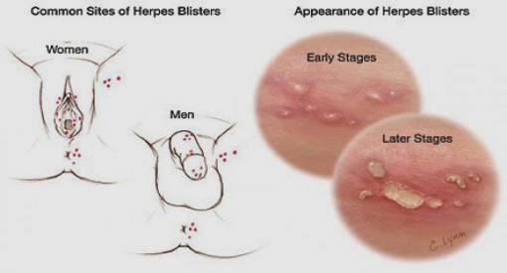
Herpes
Ulcerative infection (breaks the skin)
Contagious before, during and after an outbreak

Slide 29
Human Papillomavirus (HPV)
80% of adults/teens will have HPV in their life
Don’t forget the males!
An estimated 80 million people in the US are infected with HPV
HPV is the primary cause of reproductive organ cancers
Emerging cause of oral cancer
Approximately 100 types of HPV, 30 of which infects the genital tract
  4 are most closely linked to genital cancers
Not all HPV infections cause visible warts
Vaccine up to age 26 to protect against 4 strains of HPV

Slide 30
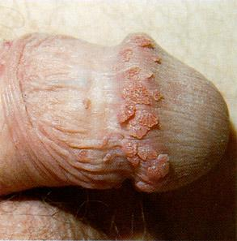
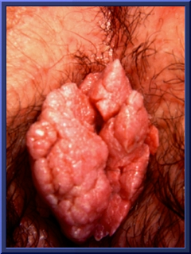
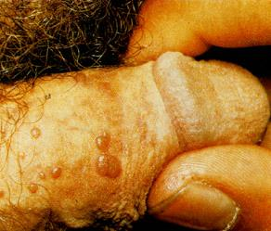
Genital Warts (HPV)

Slide 31
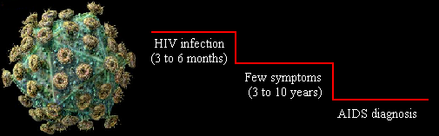
HIV
Human Immunodeficiency Virus
Window Period: Time it takes for antibodies to become detectable: usually within three months
Maximum survival is not known

Slide 32
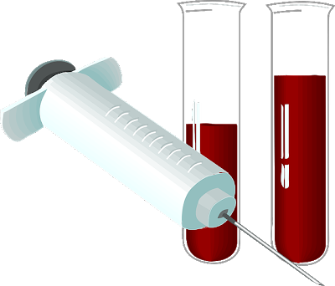
HIV Testing
Blood Testing
  other testing can be done with the same sample
Rapid Testing – results available in 1-20 minutes depending on test

Slide 33





Points about prevention
Before abstinence or safer sex comes…
  Abstinence means different things to different people at different times of the day
Safer sex is a negotiation between partners
Knowing your partners disease status

Slide 34


Slide 35
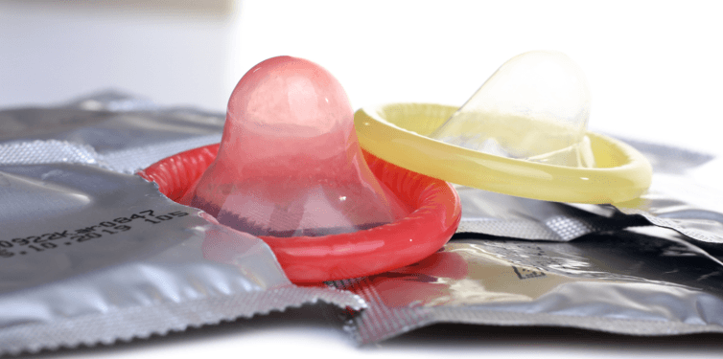
Prevention
Condoms
  Male and Female
  Used properly for each sexual act
  Options are available – find what works
Oral Barriers
  Dental dams
  Saran wrap
LUBE!!!
  Water-based, silicone, glycerin
  NO OIL BASED!

Slide 36

Prevention
Avoid sharing needles and equipment for any reason
Syringe Access Programs (needle exchange)
Know your HIV, STD status
  If a person is negative, engage in activities to stay negative
  If a person is positive, get the appropriate care to be healthier and avoid transmission

Slide 37

Prevention
PrEP
PrEP: Pre-Exposure Prophylaxis
  For individuals who do not have HIV, but are at a substantial risk of acquiring it.
  Turvada (brand name)
  Must be taken daily.
  When taken daily, it has been shown to reduce the risk of HIV infection in high risk people by 92%.
  Must see a health care provider for follow-up every 3 months.

Slide 38

U = U signifies that individuals with HIV who receive antiretroviral therapy (ART) and have achieved and maintained an undetectable viral load cannot sexually transmit the virus to others.
https://www.preventionaccess.org/faq
https://www.cdc.gov/hiv/risk/art/index.html
Notes:
This concept, based on strong scientific evidence, has broad implications for treatment of HIV infection from a scientific and public health standpoint, for the self-esteem of individuals by reducing the stigma associated with HIV, and for certain legal aspects of HIV criminalization.

Slide 39


Let’s about sexual health
“Let’s Talk About Sexual Health”
Parent
Trusted Adult
Faith based leader
School Counselor
Health Clinic
Primary Care Physician
“Let’s Talk About Sexual Health”
  https://vimeo.com/43631114

Slide 40

Where to go for testing
GetTested
National HIV, STD, and Hepatitis Testing
Find free, Fast, and Confidential Testing Near You

